Slide 1
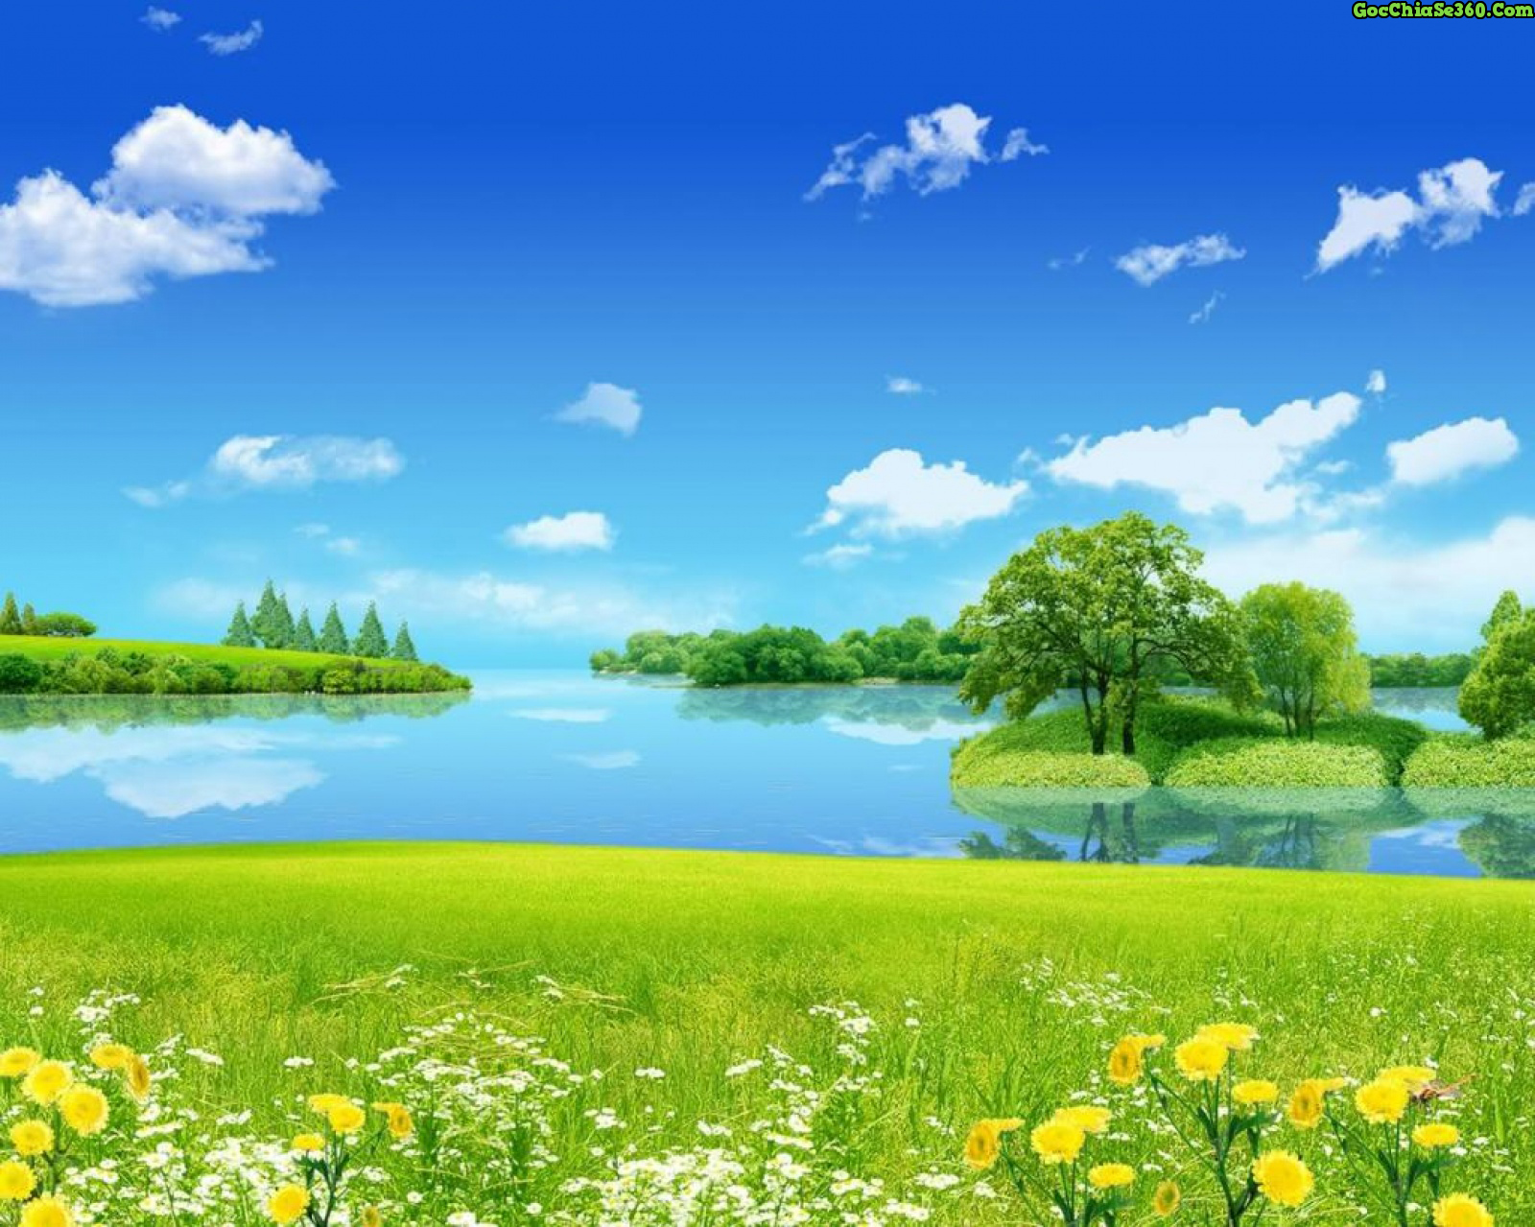
welcome to our class.

Slide 2
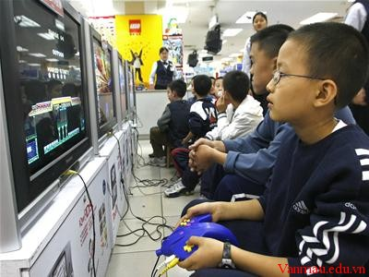
What are they doing?
Do you think playing computer games is fun?

Slide 3
Unit 1: LEISURE ACTIVITIES
PERIOD 6-LESSON 5: SKILLS 1

Slide 4
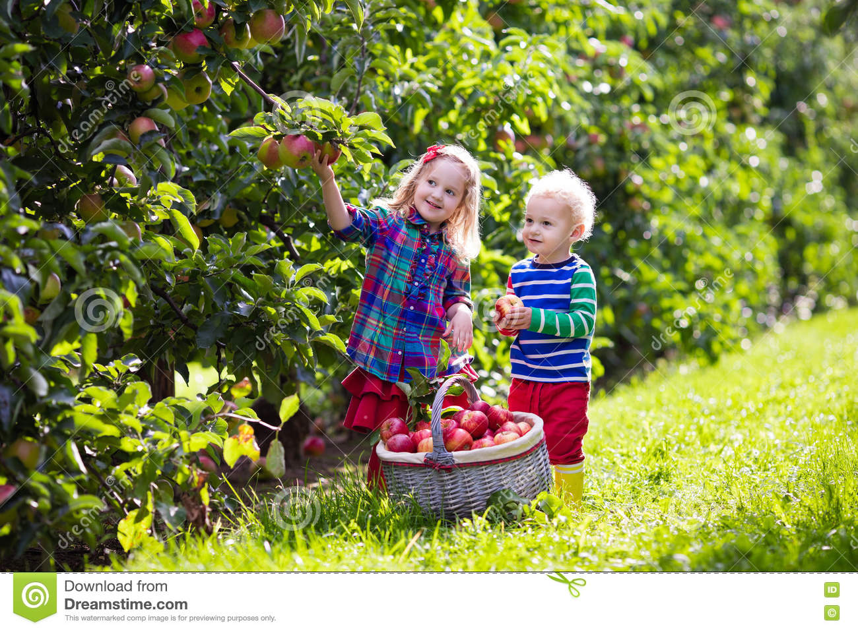
* READING
Vocabulary:
- pick the ripe fruit :
hái trái cây chín
- ‘virtual (a):
ảo
>< real : thật
- tech’nology (n)
công nghệ
- e’xist (v)
tồn tại
- ban some one from some thing / doing something:
cấm ai làm điều gì

Slide 5
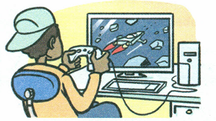
* READING
* Pre-questions
1. What are the benefits of using computers or mobile phones
for leisure activities?
2. What are the harmful things it may bring us?

Slide 6
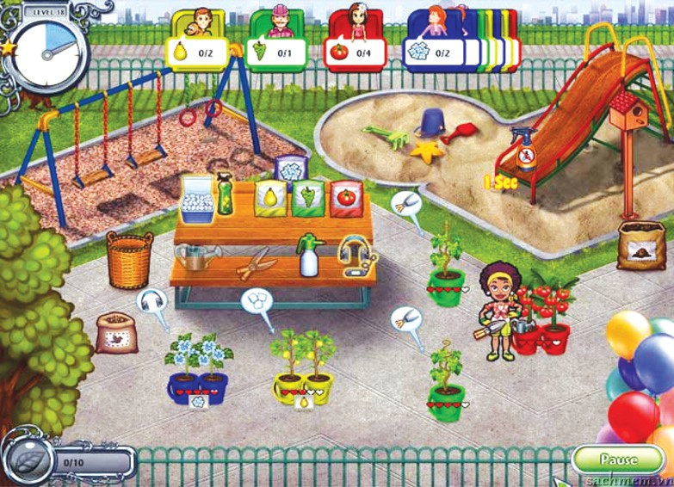
* READING
2. Read the text and choose the correct answer.
THE ‘NET GENERATION'
Quang is watering his garden and can't wait to pick the ripe fruit. He spends most of his spare time looking after the garden. Sounds great, doesn't it? But his garden is a virtual one!
In today's world, teenagers rely on technology more than in the past. This can be a problem because using computers too much may have harmful effects on both their minds and bodies. They prefer watching TV and playing computer games to reading books, perhaps because they don't have to think and imagine as much. They don't join clubs or have hobbies and they don't play sports. They sit in front of the computer all the time. They don't get out of the house, even for a walk. They are in a world that doesn't exist.
While Quang now knows the names of many plants, and his English seems to be improving as he chats with his ‘gaming friends' from all over the world, his parents are getting worried. They want him to get out more. They are even thinking of banning him from using the computer.
1. The text is about __________
A. teenagers' leisure time in the past
B. teenagers' leisure time in the
present
C. adults' leisure time in the present
2. The text discusses __________
A. the positive side of using
technology in your free time
B. the negative side of using
technology in your free time .
C. both A and B
B. teenagers' leisure time in the
present
C. both A and B

Slide 7
* READING
3. Write the questions for the answers based on information from the
text.
1. Is Quang's garden real?
- No, it isn't real. It is a computer game.
2. What is the problem with using technology in your free time?
- It can harm both the mind and the body.
3. What leisure activities do teenagers do these days?
- They don't go out but just sit in front of the computer all the time.
4. What are the benefits of using the computer?
- Quang knows the names of many plants, and his English seems to be
improving.

Slide 8
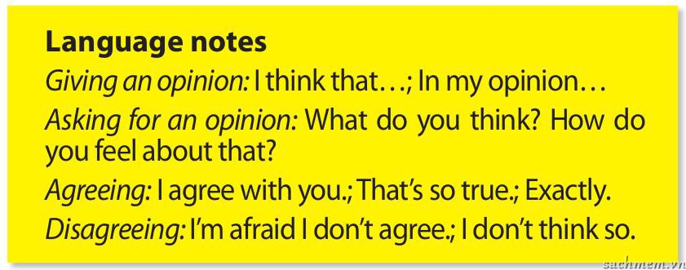
Speaking:
* Example:
A: In my opinion, computer games train your mind and your
memory.
B: That’s so true / I’m afraid I don’t agree.

Slide 9
Speaking:
4. Quang and his parents are talking about how he should spend his free time. Decide which statements are from Quang & which are from his parents. :
Sitting for too long in front of the computer makes your eyes tired
My english is much better because I surf the net.
Go out and play a sport. It’s good for you.
I think computer games train my mind and my memory.
I’ve made lots of friends from the game network.
You see your real friends less and less.

Slide 10
4. Quang and his parents are talking about how he should spend his free time. Decide which statements are from Quang & which are from his parents. :
 | Quang | Quang's parents
1. Go out and play a sport. It's good for you!
2. Sitting for too long in front of the computer makes your eyes tired.
3. My English is much better because I surf the net.
4. I think computer games train my mind and my memory.
5. I've made lots of friends from the game network.
6. You see your real friends less and less.







Slide 11
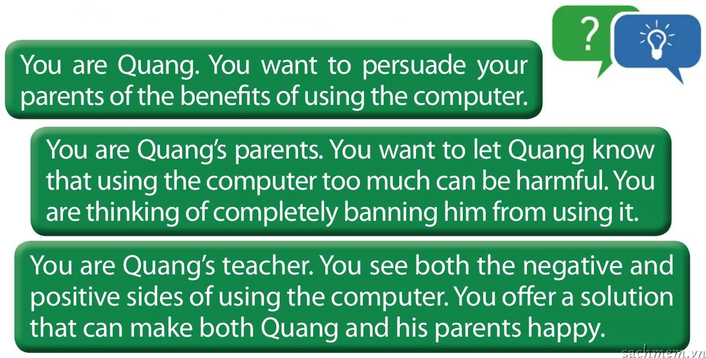
5. Role-play: WHAT’S THE SOLUTION?
Quang, his parents, and his teacher are discussing the impacts of his
using the computer. Play the following roles.

Slide 12
HOMEWORK:
- Read the passages again and try to remember the
vocabulary and practices
Practice talking about the impacts of using the computer..
Do the exercises in the workbook.
Prepare skills 2 : + Find out new words
+ Read – writing to give an opinion

